Slide 1
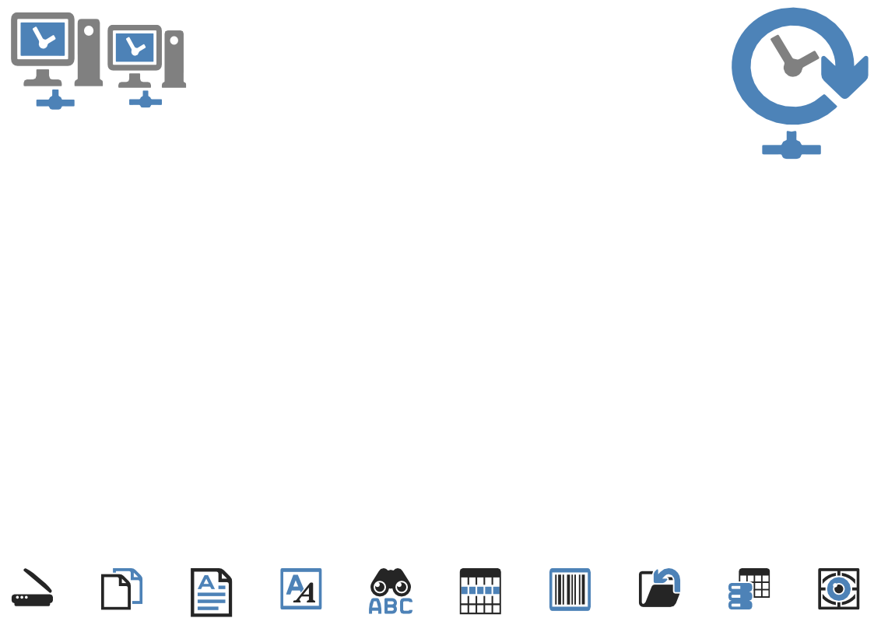
ChronoScan
M-Files Import Module
NEW – Fully Automate AI and non AI Capture Workflows Directly From an M-Files Vault
Using the new ChronoScan/M-Files Import Module you can,
Automatically monitor a vault for new documents and/or bulk import existing documents
Define custom import filters to only process the files you need
OCR using a choice of engines including the new Google AI Vision OCR/ICR engine
Create text searchable PDF files and/or image files without OCR and replace/add to a vault
Utilise ChronoScans OpenAI GPT and Open Source LLMs for automated classification and metadata capture
Create complex data capture and extraction applications
Intelligent Capture, where you need it, when you need it.
Set and forget to work smarter not harder!

Slide 2
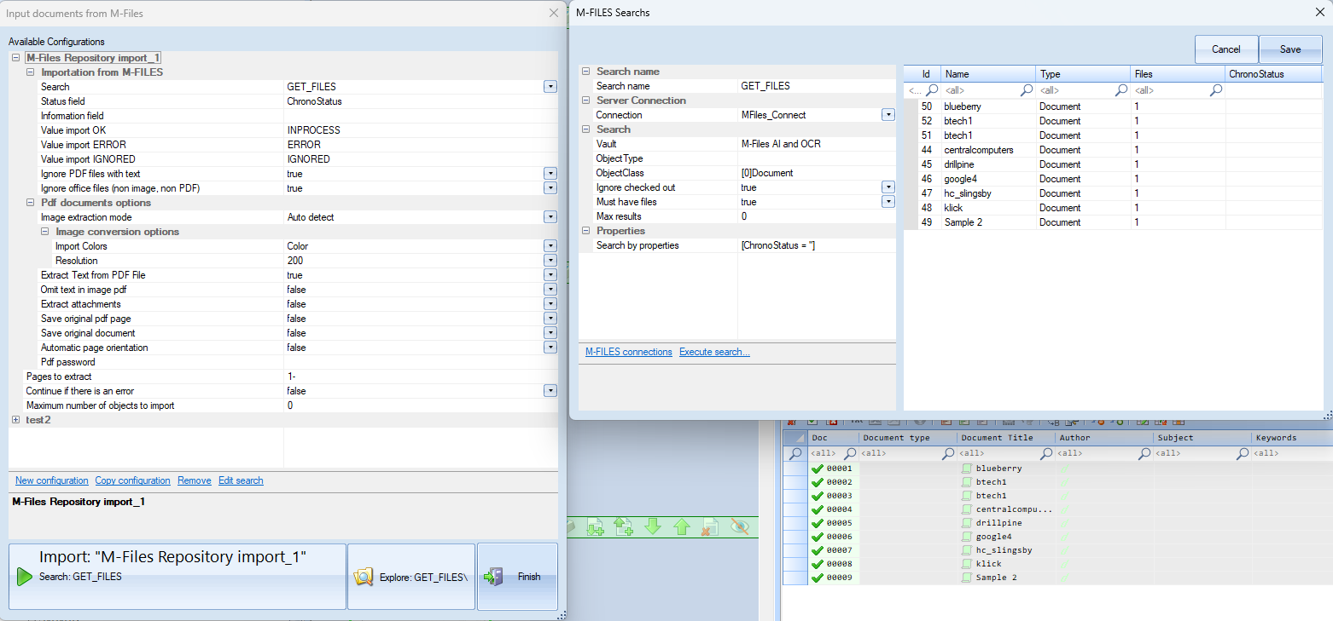
Workflow Setup
1 - Define your search and import parameters & execute test to verify

Slide 3
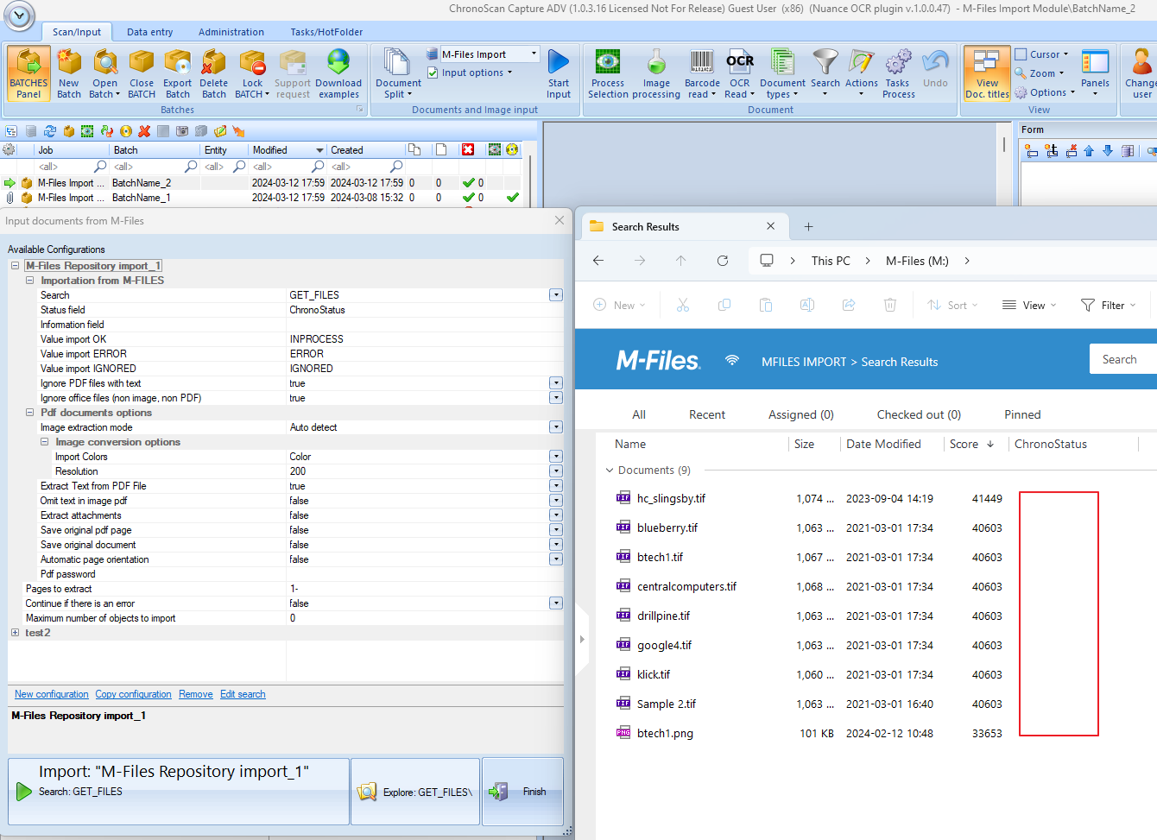
Workflow Setup
2 – Add your import module to a new or existing job to create batches
In this example we will import image type documents where the status (“ChronoStatus”) is NULL and add to a job that will perform OCR, create a hyper-compressed PDF and replace the current document in the vault

Slide 4
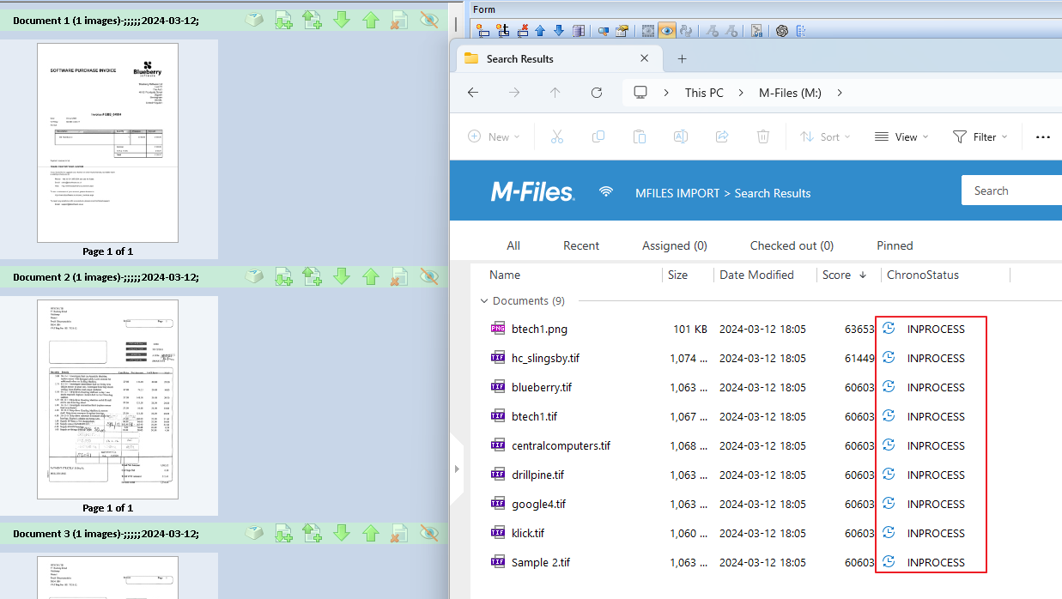
Workflow Setup
2.1 – Import execution
Documents are imported to the batch and the status in M-Files is updated to the current state.

Slide 5
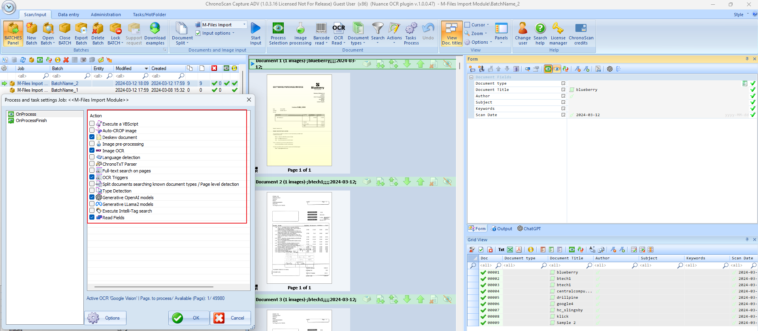
Workflow Setup
2.2 – Processing task options
The import filter can be used with any currently configured job, from simple full text OCR & hyper-compression to complex metadata extraction.

Slide 6
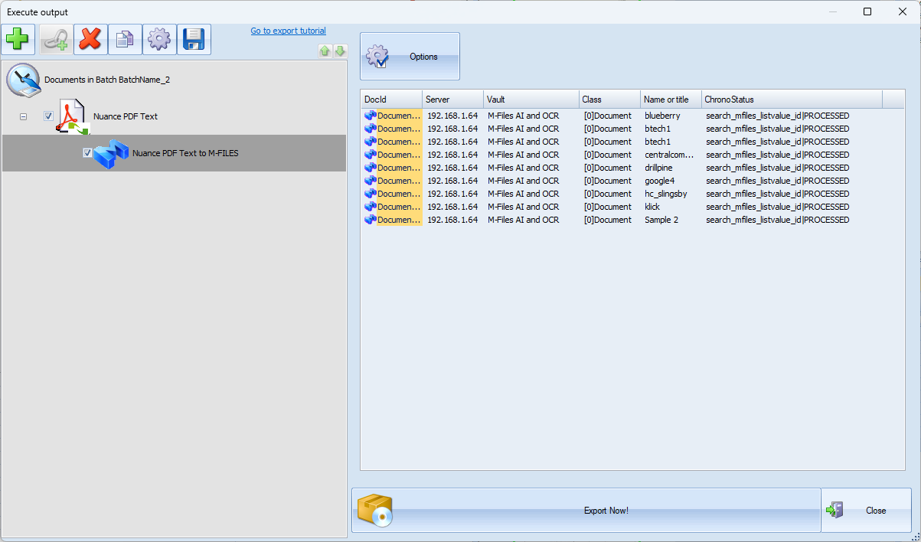
Workflow Setup
2.3 – Document Export
Documents are then returned to the vault to replace the documents with the newly processed files and metadata if applicable.

Slide 7
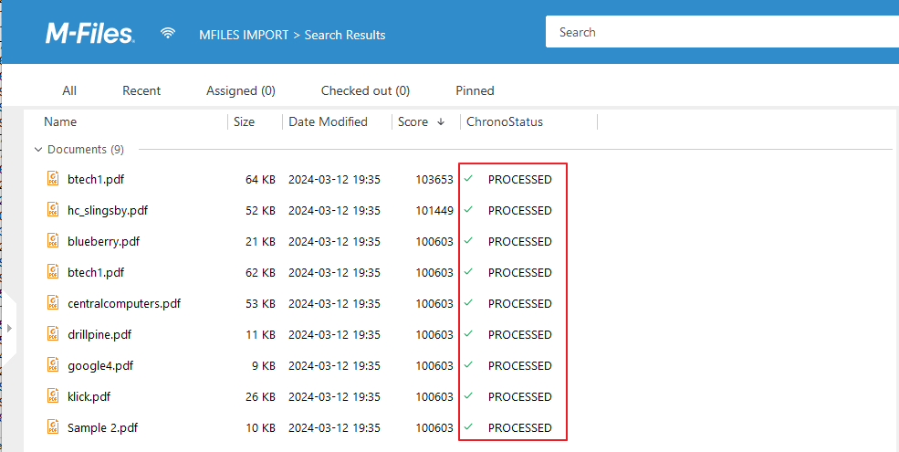
Workflow Setup
2.4 – Processing task options
In the final step the converted and OCR’d documents are uploaded to the vault together with the updated status.

Slide 8
Summing Up
The new M-Files import module brings many new and exciting options and opportunities to Mfilers even if you don’t use all of the advanced capture and extraction functionality this module will enable users to OCR image based documents in their vaults and save them as hyper-compressed PDF or convert to other formats such as PDF/A. For current ChronoScan users of the Enterprise and Advanced editions this new module is included as standard.
For further information please email pafowkes@chronoscan.org

